Slide 1
Introduction to NAMD
SHUG-2015
Jose M. Borreguero
Neutron Data Analysis and Visualization Division
Center for Accelerating Materials Modelling

Slide 2
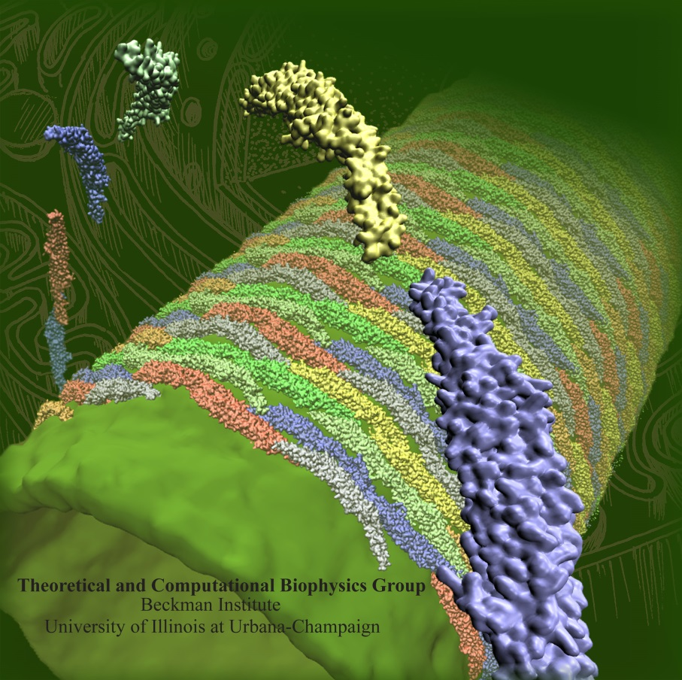
Not (just) Another Molecular Dynamics
http://www.ks.uiuc.edu/Research/namd
Free to use and easy to install
Accepts various popular force fields
AMBER, CHARMM, X-PLOR
Highly efficient when running in parallel
Multiple environments available
different thermodynamic ensembles
external fields defined by user
Complex dynamic schemes
restraints
replicas
free energy calculations

Slide 3
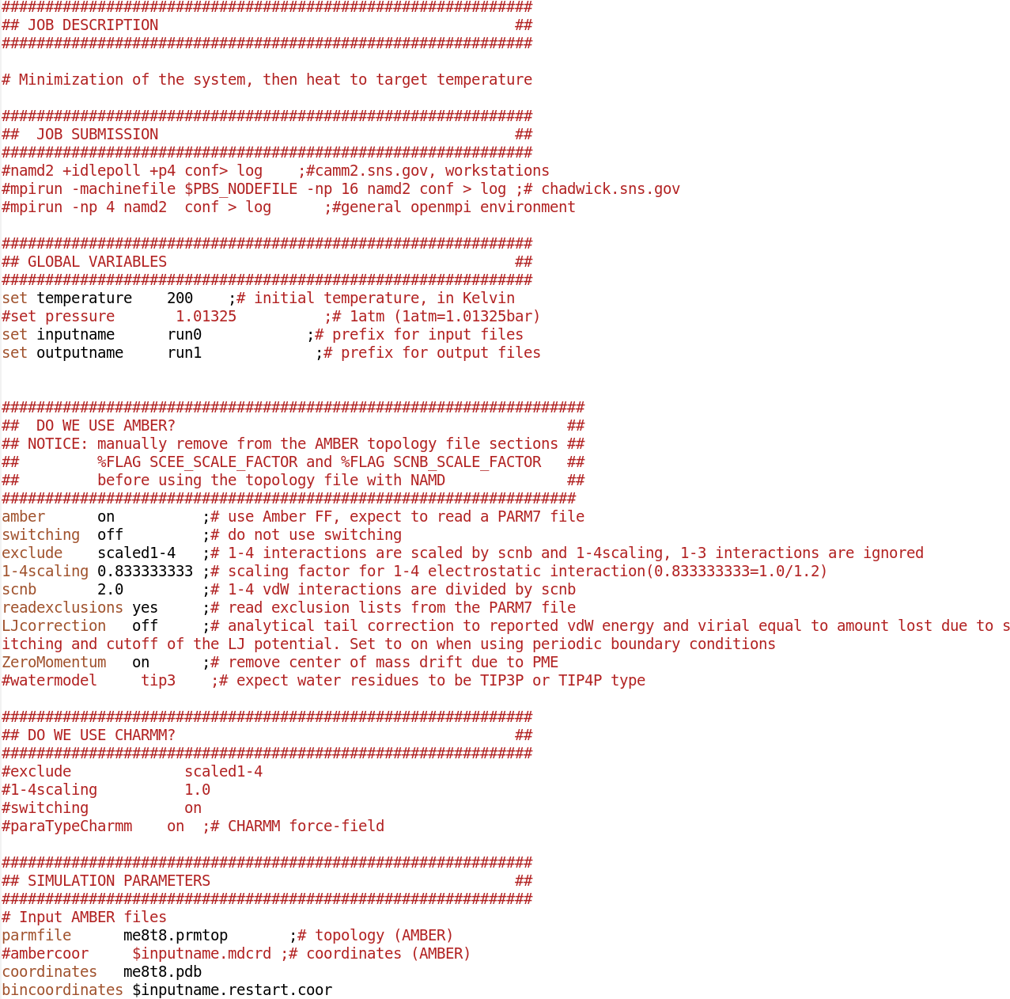
Walkthrough: Input configuration file

Slide 4
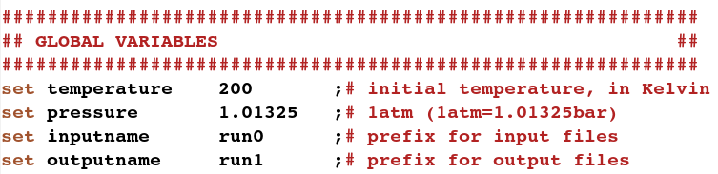
Global variables
You can define as many variables as you want with the set command.
Prepend “$” when calling them.
$temperature
$pressure

Slide 5
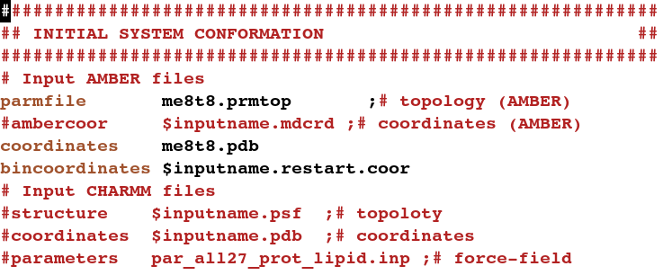
Initial system conformation
topology file (.prmtop)
list of bonds
atom types
list of atoms Atom and molecules (.pdb)
coordinates (.coor)
velocities (.vel, not-required in the NVT, NPT ensembles)

Slide 6
Integrator Parameters

